Slide 2
Downsampling
Downsampling enable faster work
Methods can be divided into …
Voxel Grid-based method
Farthest point sampling(FPS)-based method
Normal Space sampling-based method

Slide 3
Voxel Grid Downsampling
Using regular voxel grid to create a uniformly downsampled pointcloud
Each voxel retains single representative value of bucketed pointcloud
Center of voxel
Centroid of points
Closest point to centroid
Both PCL and Open3D utilize centroid

Slide 4
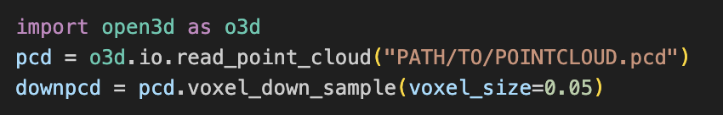
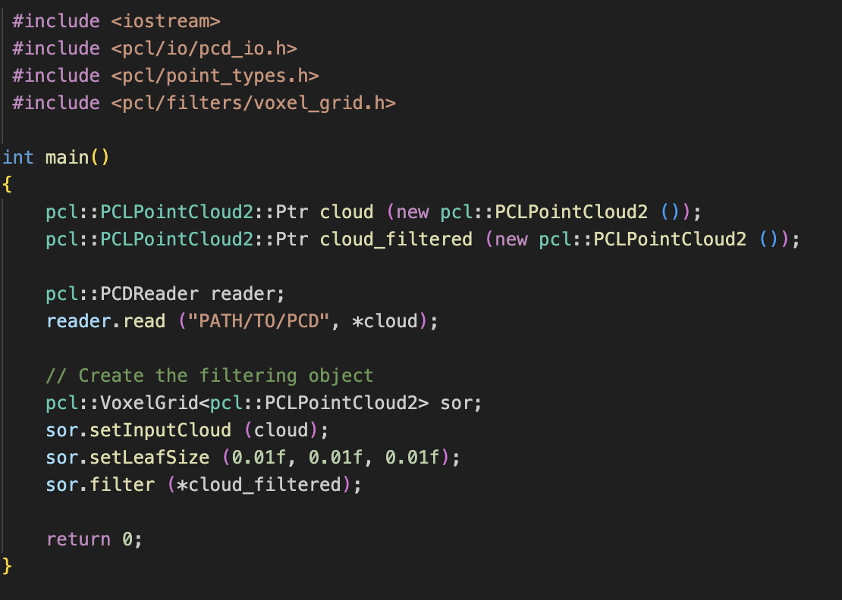
Voxel Grid Downsampling in code
Open3D
PCL

Slide 5
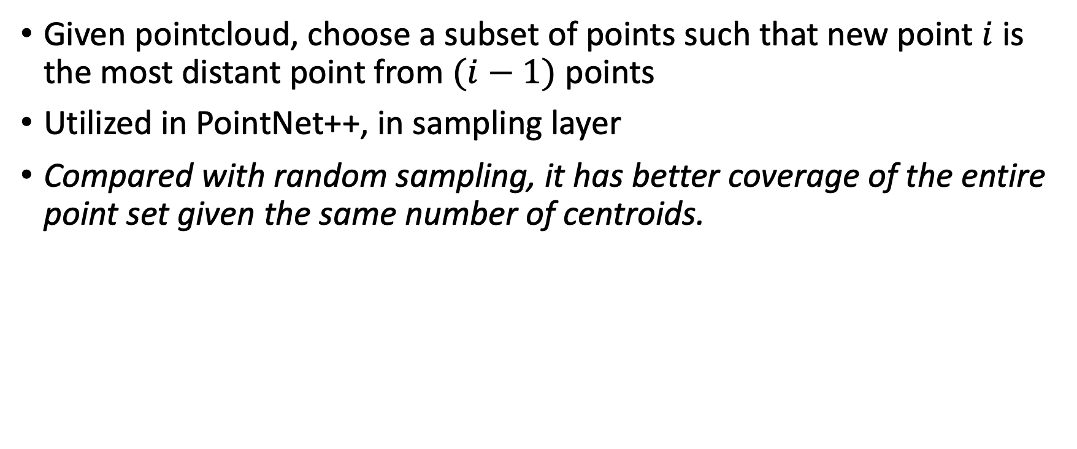
Farthest Point Sampling (FPS)
Given pointcloud, choose a subset of points such that new point $i$ is the most distant point from $(i−1)$ points
Utilized in PointNet++, in sampling layer
Compared with random sampling, it has better coverage of the entire point set given the same number of centroids.
https://gist.github.com/ctralie/128cc07da67f1d2e10ea470ee2d23fe8

Slide 6
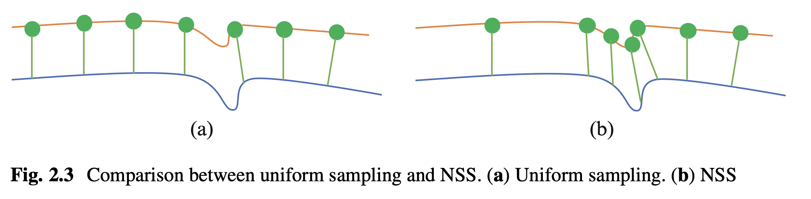
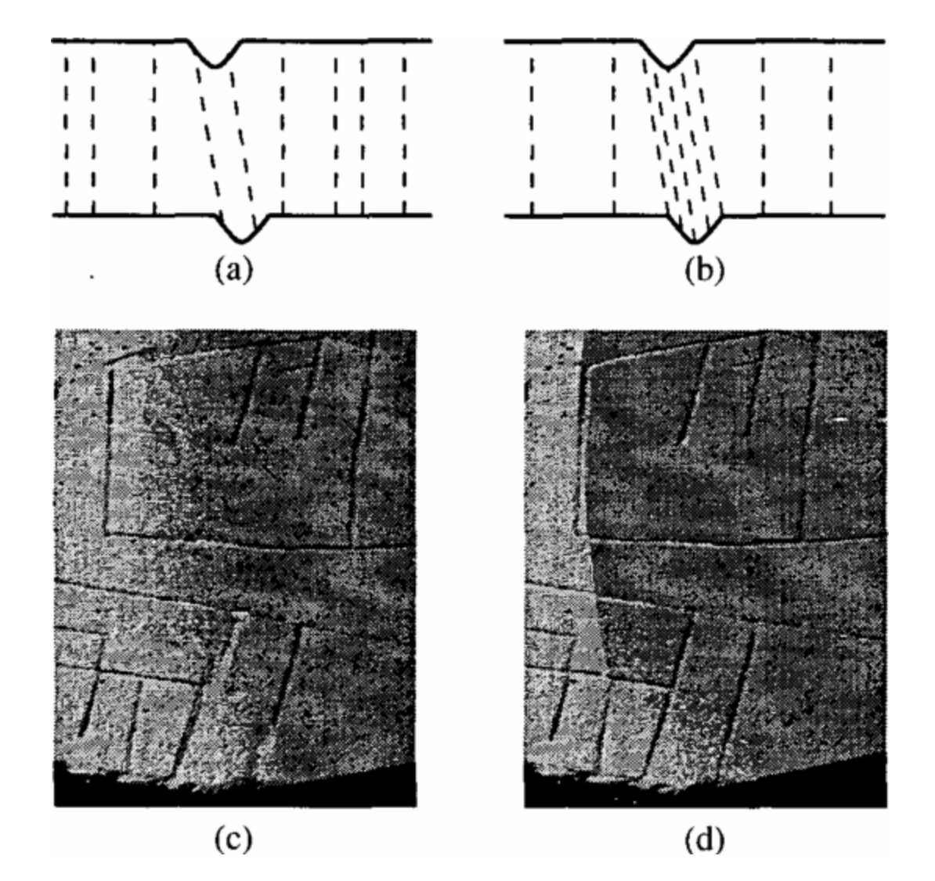
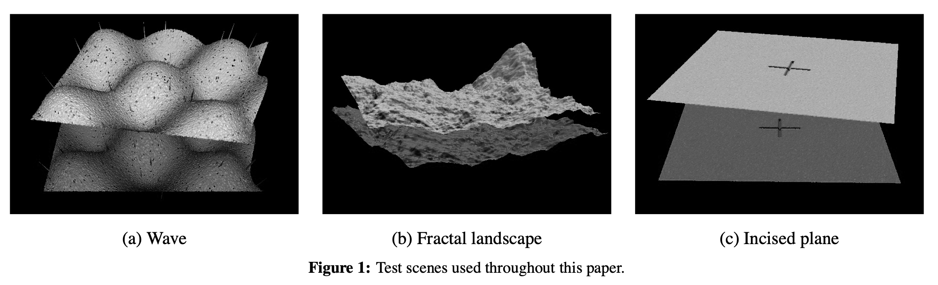
Normal Space Sampling
Introduced in “Efficient Variants of the ICP Algorithm (01’ 3DIMPVT)”
Construct a histogram of surface normal, and uniformly sample points from all bins until desired number of point is reached.

Slide 7
Normal Space Sampling
“choosing points such that the distribution of normals among selected points is as large as possible. The motivation for this strategy is the observation that for certain kinds of scenes (such as our “incised plane” data set) small features of the model are vital to determining the correct alignment. A strategy such as random sampling will often select only a few samples in these features, which leads to an inability to determine certain components of the correct rigid-body transformation. Thus, one way to improve the chances that enough constraints are present to determine all the components of the transformation is to bucket the points according to the position of the normals in angular space, then sample as uniformly as possible across the buckets.”

Slide 8
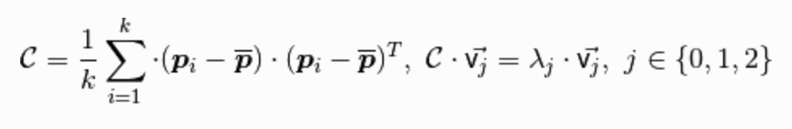
Finding Surface Normal
Find neighbor points and create a 3x3 covariance matrix
apply PCA to it, and select eigenvectors with the smallest eigenvalue

Slide 9
Noise Removal
Radius Outlier Removal
Statistical Outlier Removal

Slide 10
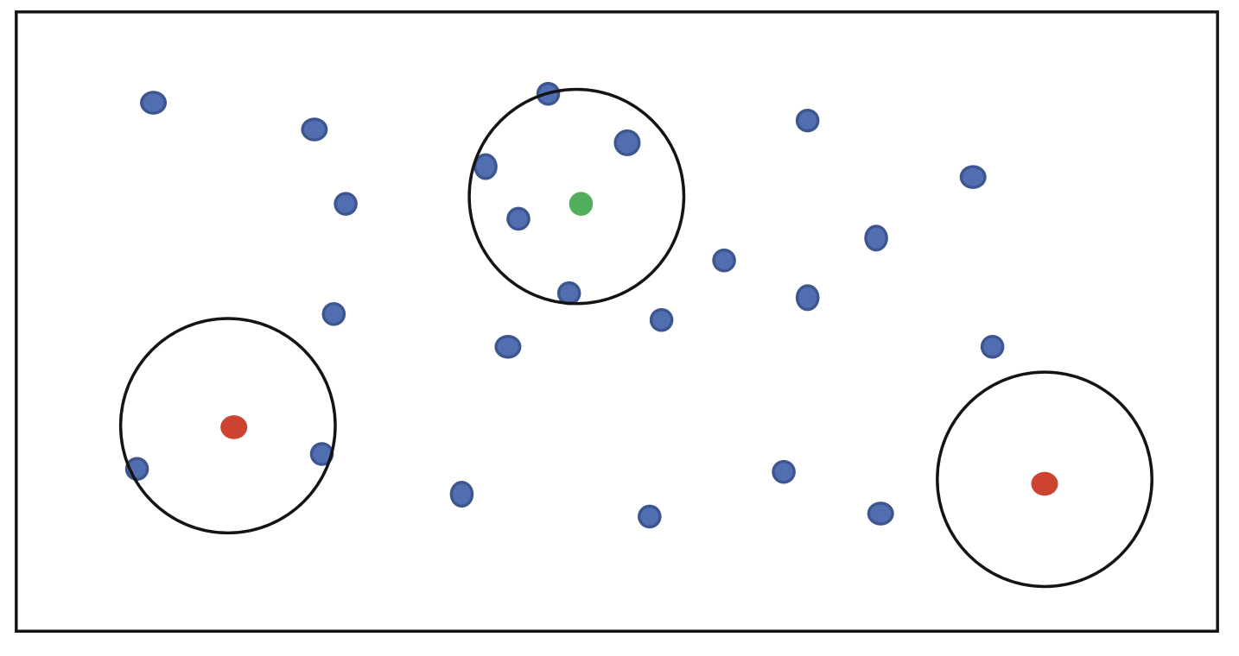
Radius Outlier Removal
For each point, find its neighbor inside radius (sphere)
If the number of neighbor is lower than the threshold, it is outlier
Available both in PCL and Open3D

Slide 11
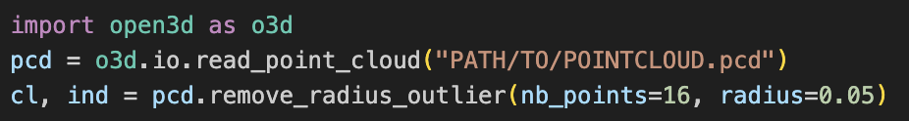
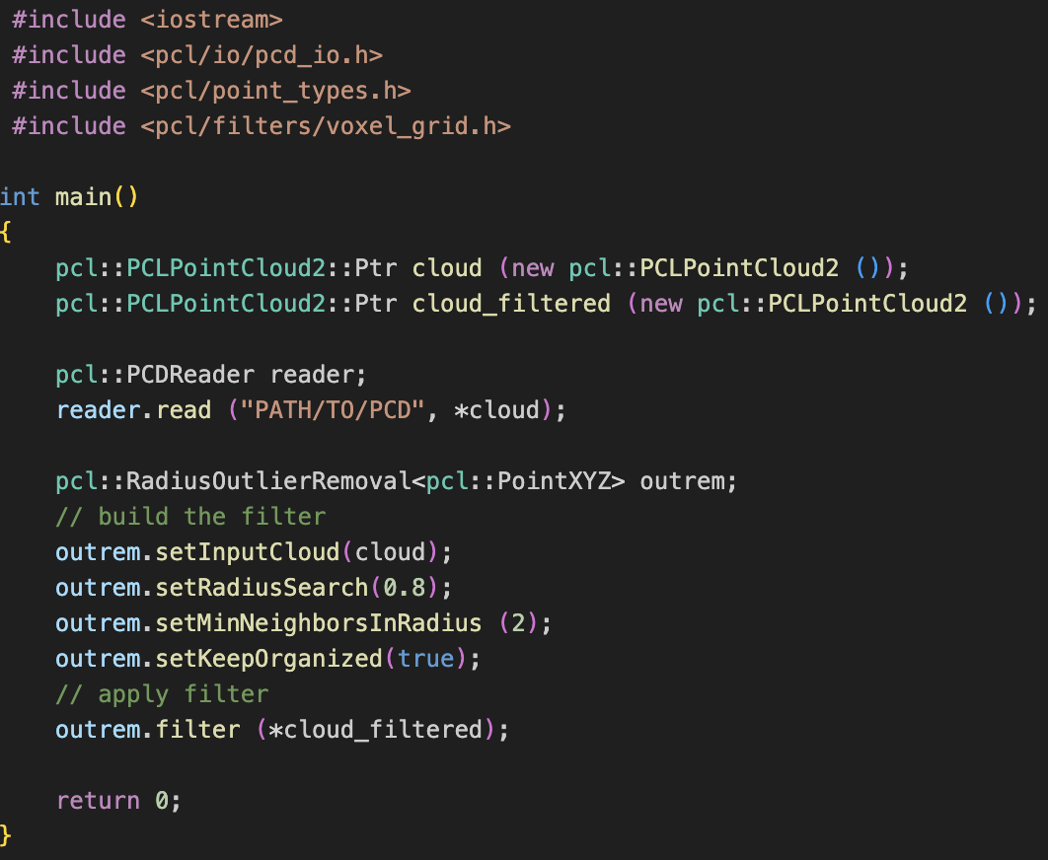
Radius Outlier Removal
Open3D
PCL

Slide 12
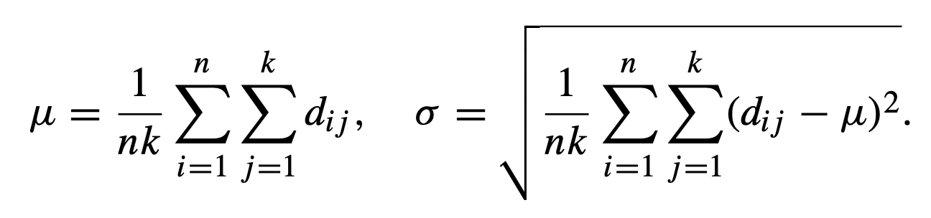
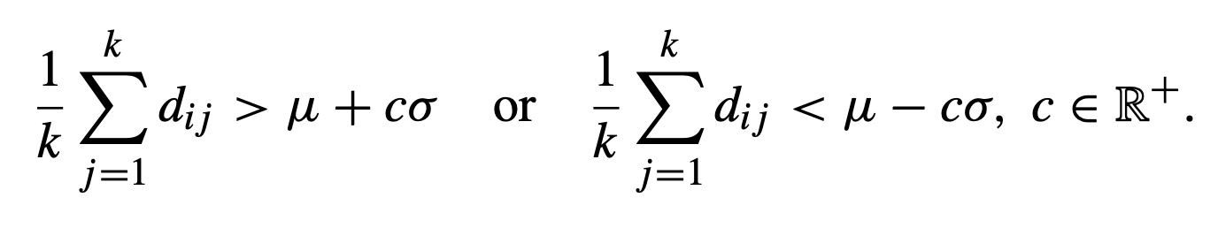
Statistical Outlier Removal
For each point, compute the mean distance from it to all its neighbors
By modeling distances as Gaussian distribution, get mean / std. dev.
All points whose mean distances are outside the interval is outlier

Slide 13
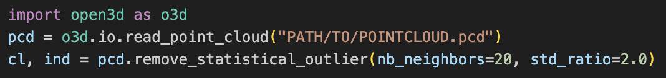
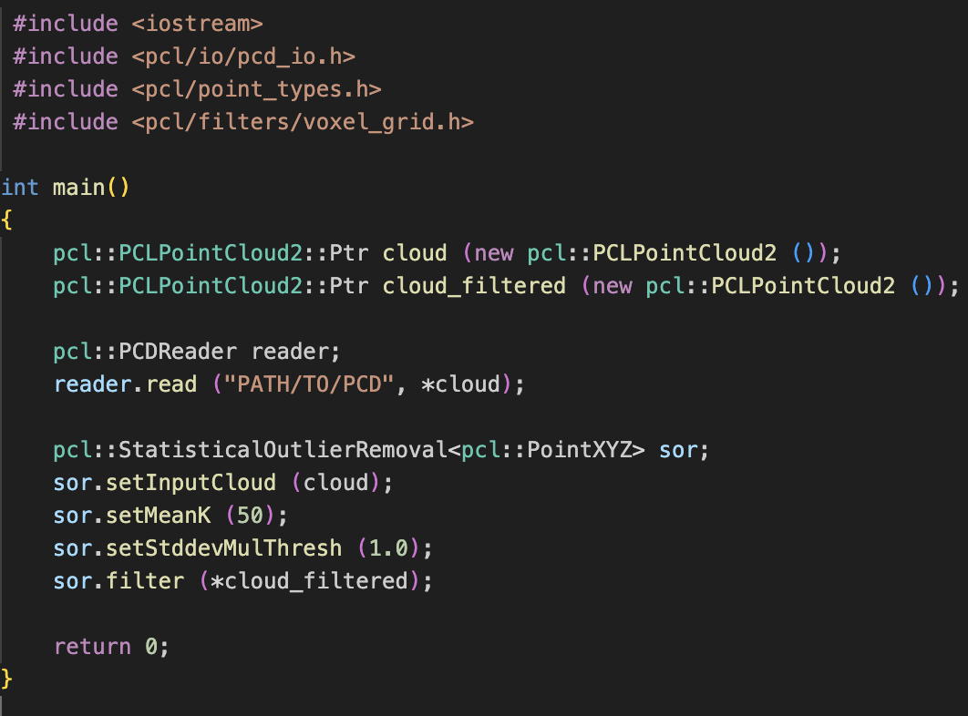
Statistical Outlier Removal
Open3D
PCL

